Slide 1
Entertainer Analysis

Slide 2
Introduction
The entertainment industry offers a welcome escape from daily stress, encompassing film, television, radio, and print media like movies, TV shows, music, news, and more. Our dashboard analyzes achievements such as the Grammy Awards and Oscars, showcasing how entertainers shape culture, inspire global audiences, and achieve industry recognition.

Slide 3
Details of the data
Exploring entertainer data offers insights into their careers, achievements, and cultural impact. The dataset includes essential details such as birth years, pivotal breakthroughs or #1 hits, notable award nominations, and the years of their first major awards like Oscars, Grammys, or Emmys. It also tracks their last significant works and, if applicable, the year of their passing. These data points provide a comprehensive view of each entertainer's journey, highlighting their milestones and contributions to the entertainment industry.

Slide 4
Page1- Overview Insights
Main KPIs:
Total Nominees
Emmy’s/Grammy’s Won for Singers
Oscars Won for Actors
Total Awards + Other Awards
First Profession
First Breakthrough Item (Song, Movie, Album etc.)
A bird’s eye view of the actors and singer data and the awards they won.

Slide 5
Page2 – Overall Analysis
Pie Chart: This pie chart illustrates the dataset's distribution between Singers and Actors. Actors dominate with 68%, indicating a preference for acting over singing. This trend suggests that acting may be perceived as requiring fewer skills than singing, often being more profitable.
Nominees vs Awards Won Stack Bar Chart: This chart compares the number of awards won by entertainers to the number of nominations they received. Meryl Streep stands out with the most awards won and holds the record for the highest number of nominations.

Slide 6
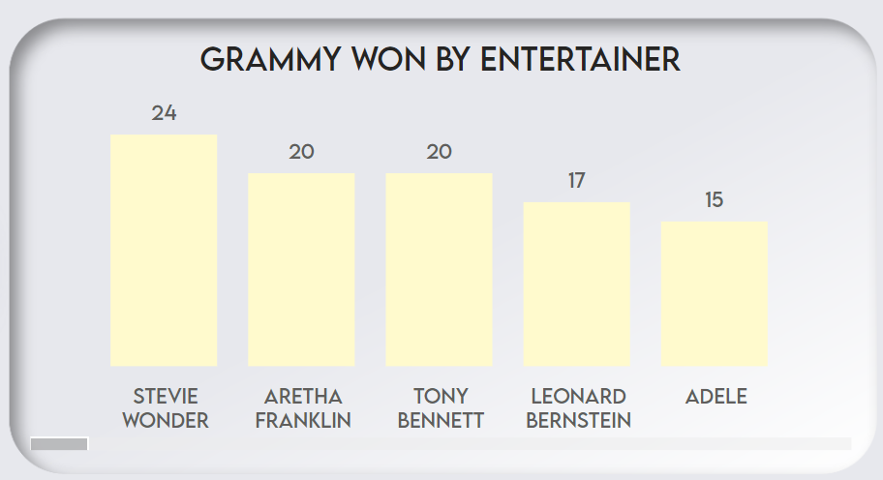
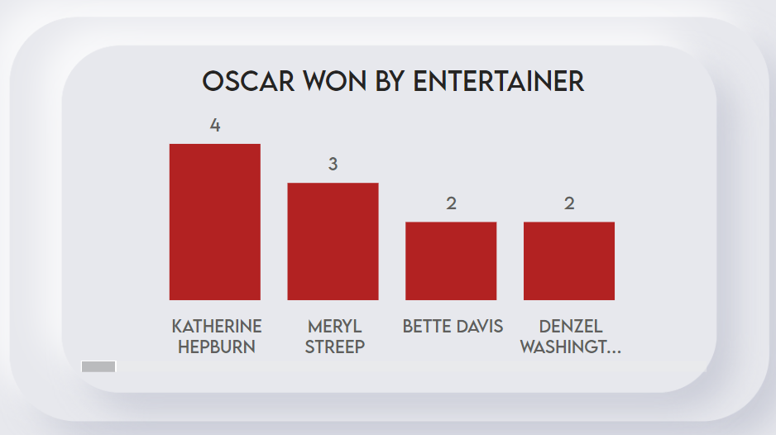
Page3 – Awards Analysis
This page lists all Grammy and Oscar holders.
These bar charts display the number of Grammy and Oscars won by each entertainer. Grammys are typically awarded to singers, while Oscars are awarded to actors. For instance, Stevie Wonder leads with 24 Grammy awards, the highest in our dataset, while Katharine Hepburn has won only 4 Oscars. This discrepancy may reflect the relative difficulty of achieving Oscars compared to Grammys, possibly influenced by the number of actors and singers in our dataset.
People may lean towards acting over singing because singing often requires natural vocal talent, which not everyone possesses, whereas acting can be developed as a skill.

Slide 7
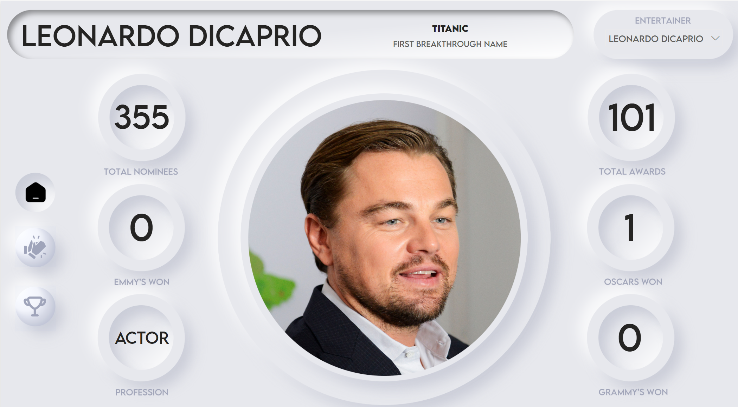
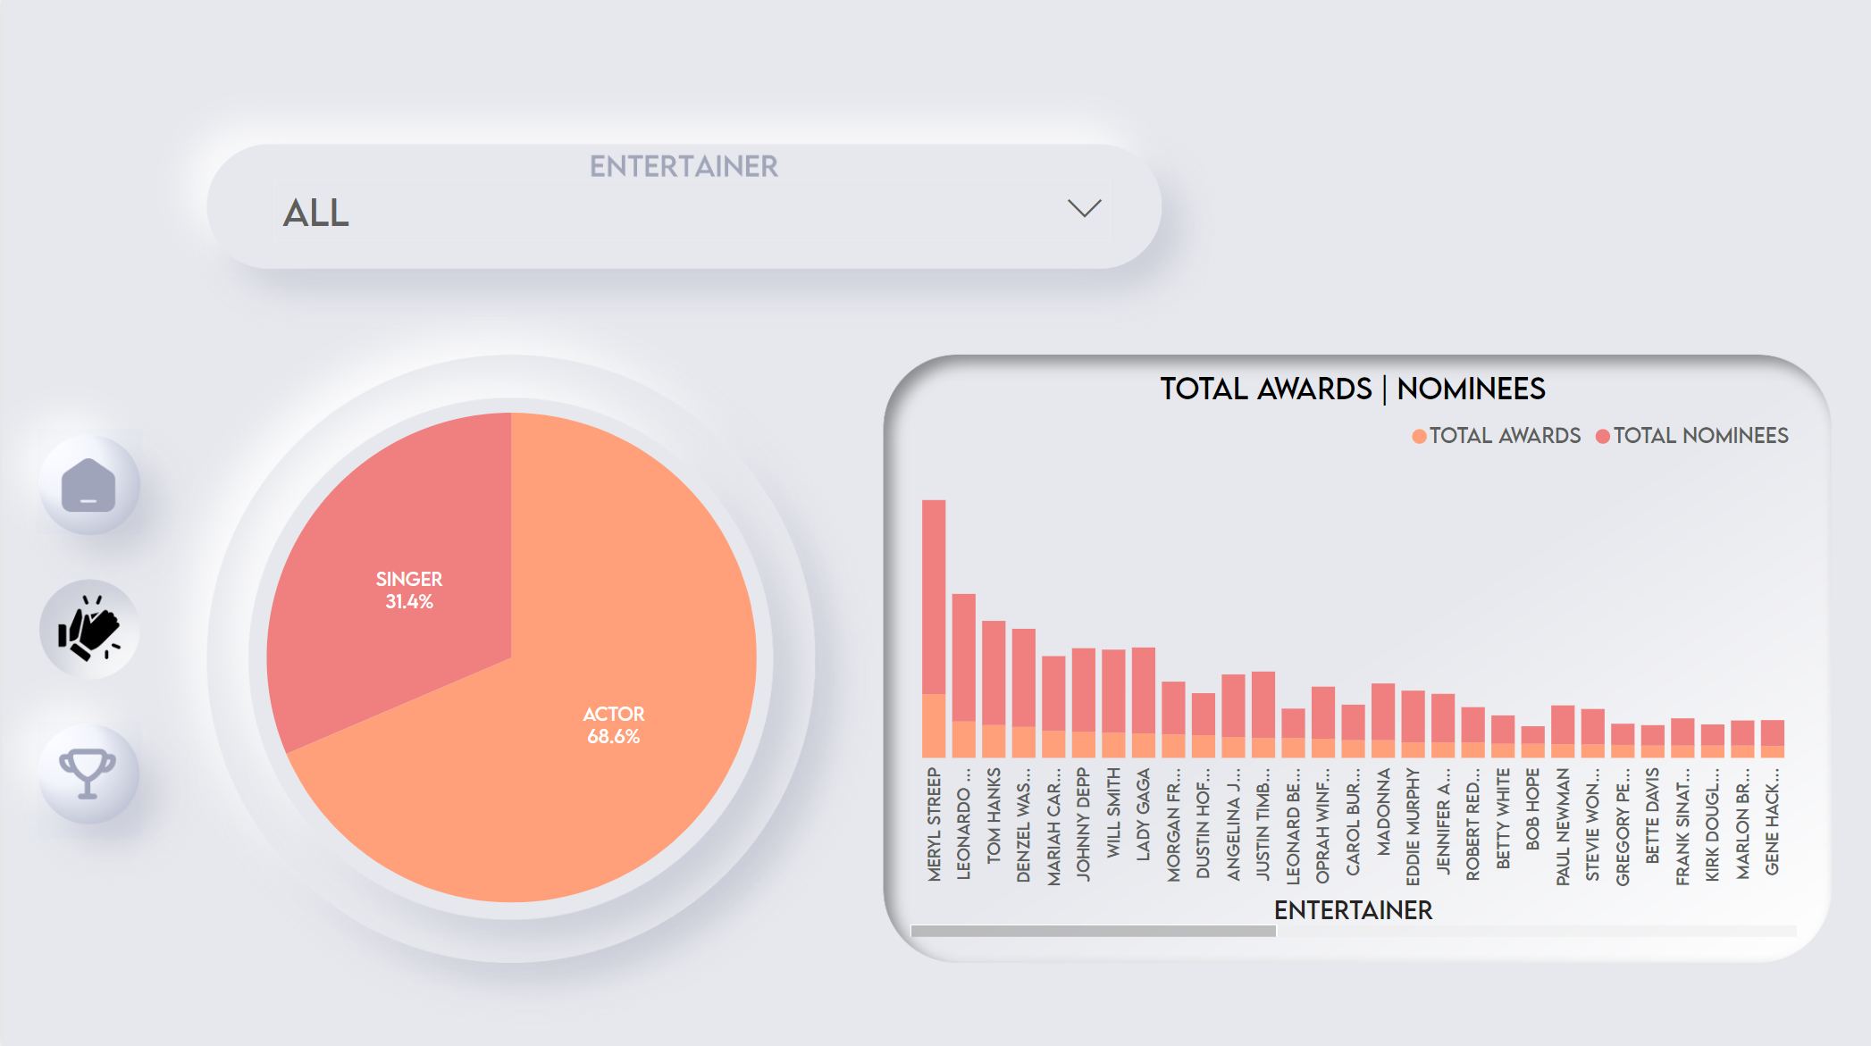
My Design
Link to Report

Slide 8
Thank you

